Slide 1
Python Project
M. Haidar Aziz
Ahmed Bari
‘Hangman Game Using Python’

Slide 2
Game Overview:
Hangman is a classic word-guessing game where players try to guess a secret word by guessing individual letters
The player has a certain number of turns (in this case, 10) to guess the word, and for each incorrect guess, a part of a stick figure is drawn.
If the player successfully guesses the word before the stick figure is fully drawn, they win the game. If the stick figure is fully drawn before the word is guessed, the player loses.

Slide 3
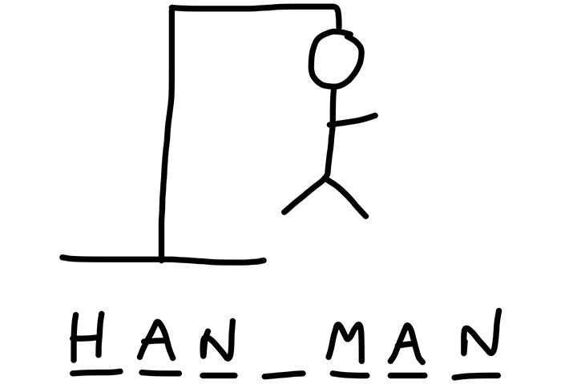
This is how a Hangman game looks.. But Let’s Make This Game using Python.

Slide 4
Basic Components of the program
Libraries (random, openpyxl)
Data Entry
Function Declaration
For loop
While loop
List
User Input
Data Types

Slide 5

Basic Logic
Import two libraries:
random (to select random word)
openpyxl (to make an excel file)
os (operating system)

Slide 6
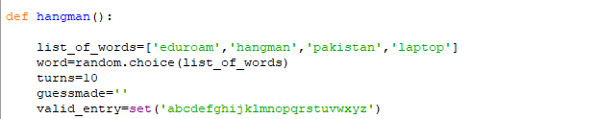
Make a function named hangman.
Make a list of words
A random word from the list is selected using a function random.choice() from random library
Store the random word in the variable word
Turn variable is used to keep the track of the number of chances the player has to guess the words
Initialize empty string to store the letters the player has already guessed
Specify a set of valid entries

Slide 7
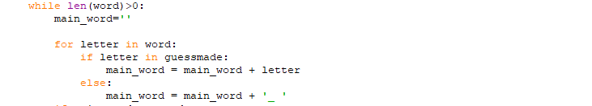
Start a loop that will continue until the “word” length is greater than 0
“main_word” store the word that is displayed to the player, with unguessed letters replaced by underscores
Start a for loop that will iterate over each letter in “word”
Apply if condition to check whether the letter in loop has already been guessed by the player
If letter has alredy been guessed, it is added to the “main _word” string.
If not else block execute and add underscore and a space to the “main_word”

Slide 8

This if condition will check whether the “main_word” string is equal to”word”
If both are equal print line will print “main_word” and congrats msg
Break will cause the exit from the loop

Slide 9
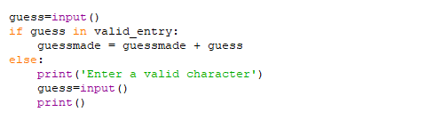
Take input from the player and store it in an variable “guess”
First if condition will check whether the player made valid entry if yes it is added to the “guessmade” string
If not else block will execute and print the statement
Second input prompt the player to enter another guess

Slide 10
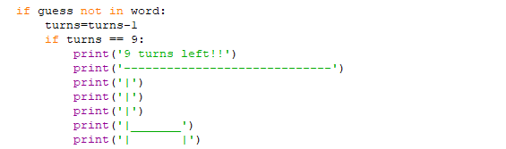
Second if condition will check whether the guess made by the player us not present in the word
If guess is not present the number of remaining turns is decremented by 1
Use nested if in place of elif
The block check if the number of remaining turns is 9. if it is the hangman ASCII art is printed along with the msg “9 turns left”

Slide 11
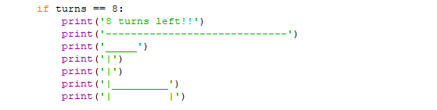
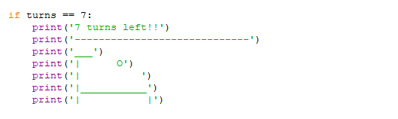
The block check if the number of remaining turns is 8. if it is the hangman ASCII art is printed along with the msg “8 turns left”
The block check if the number of remaining turns is 7. if it is the hangman ASCII art is printed along with the msg “7 turns left”

Slide 12
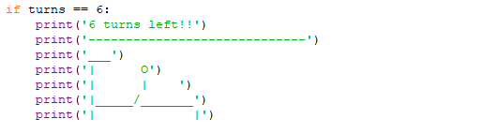
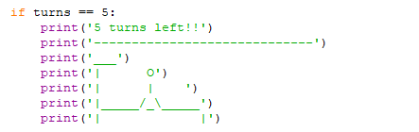
The block check if the number of remaining turns is 6. if it is the hangman ASCII art is printed along with the msg “6 turns left”
The block check if the number of remaining turns is 5. if it is the hangman ASCII art is printed along with the msg “5 turns left”

Slide 13
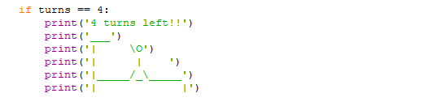
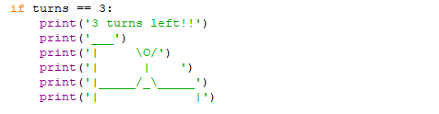
The block check if the number of remaining turns is 4. if it is the hangman ASCII art is printed along with the msg “4 turns left”
The block check if the number of remaining turns is 3. if it is the hangman ASCII art is printed along with the msg “3 turns left”

Slide 14
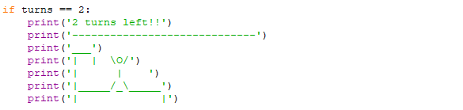
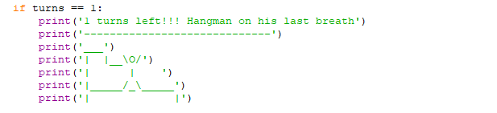
The block check if the number of remaining turns is 2. if it is the hangman ASCII art is printed along with the msg “2 turns left”
The block check if the number of remaining turns is 1. if it is the hangman ASCII art is printed along with the msg “1 turns left”

Slide 15
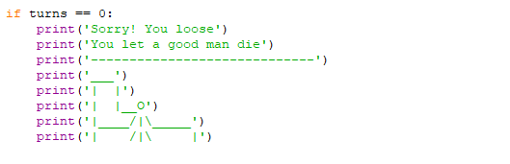
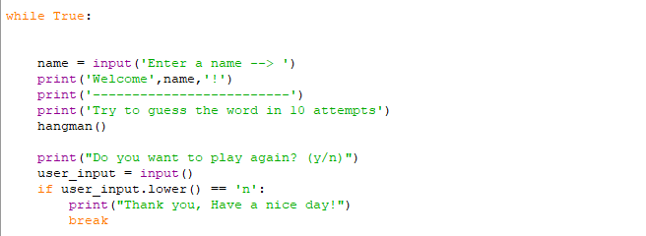
The block check if the number of remaining turns is 0. if it is the hangman ASCII art is printed along with the msg “you loose” and “you let a good man die
Infinite while loop starts
Take user name as input
Print some statements
Call the hangman() function
Take user_input whether he wants to play again
if not farewell msg printed
And function breaks

Slide 16
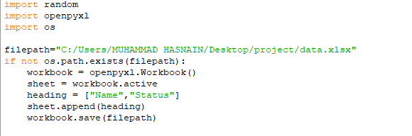
Import openpyxl (python library for reading and writing excel files)
Import os (for interaction with operating system)
Give a path to make an excel workbook
If condition will check whether the file specified by “filepath” exist or not
If not than it will make the file using openpyxl.Workbook() function
Sheet variable get the active sheet of the workbook
Create a list with two strings “Name” and “Status”
Add heading list as a new row to the end of active sheet
This line save the workbook to the specified filepath

Slide 17
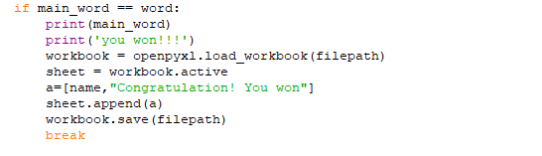
Open excel workbook from the file specified by the path
Get active sheet of the workbook
Create a list (a) contains the player name and string “you won”
Append list a as a new row to the end of the sheet
Save the workbook

Slide 18
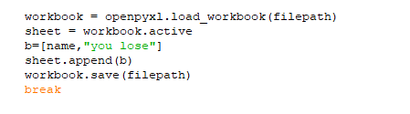
Open excel workbook from the file specified by the path
Get active sheet of the workbook
Create a list (b) contains the player name and string “you lose”
Append list (b) as a new row to the end of the sheet
Save the workbook

Slide 19
Complete Description:
To develop the Hangman game, we first created a list of words that can be used as the secret word for the game.
We then wrote a function to randomly select a word from the list and assign it to a variable.
Next, we wrote a loop that continues until either the player has successfully guessed the word or they have run out of turns.
Within the loop, we check if the player's guess is correct, and if it is, we update the variable that keeps track of the correct
letters to include the new guess.
If the guess is incorrect, we decrease the number of turns left and draw a part of the stick figure.
Finally, we added handling for invalid guesses, such as guesses that are not letters or that have already been made.
We also added excel file to save player name’s with the final result of their play.

Slide 20
Thank You

